Slide 1
Python Seminar
JOURNEY FROM BASICS TO ADVANCED WITH A LIVE PROJECT VIRTUAL ASSISTANT WITH PYTHON

Slide 2
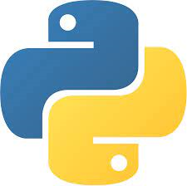
Introduction to Python
Python is a popular programming language. It was created by Guido van Rossum, and released in 1991.
It is used for:
Web development (server-side)
Software Development
Mathematics
System Scripting

Slide 3
What can Python do ?
Python can be used on a server to create web applications.
Python can be used alongside software to create workflows.
Python can connect to database systems. It can also read and modify files.
Python can be used to handle big data and perform complex mathematics.
Python can be used for rapid prototyping, or for production-ready software development

Slide 4
Why Python ?
Python works on different platforms (Windows, Mac, Linux, Raspberry Pi, etc).
Python has a simple syntax similar to the English language.
Python has syntax that allows developers to write programs with fewer lines than some other programming languages.
Python runs on an interpreter system, meaning that code can be executed as soon as it is written. This means that prototyping can be very quick.
Python can be treated in a procedural way, an object-oriented way or a functional way.

Slide 5
01
Basic Syntax
02
Variable and Data Types
Learn the Basics
03
Conditionals
04
Type Casting , Exceptions

Slide 6
05
Functions, Built-in Functions
06
List , Tuples & Dictionaries
Learn the Basics
07
Iterators
08
Modules

Slide 7


Python Syntax
Python syntax can be executed by writing directly in the Command Line:

Slide 8
Python Comments
Comments can be used to explain Python code.
Comments can be used to make the code more readable.
Comments can be used to prevent execution when testing code.
Creating a Comment
Comments start with #

Slide 9
Python Variables
Variables are containers for storing data values.
Python has no command for declaring a variable.
A variable is created the moment you first assign a value to it.
Variables do not need to be declared with any particular type, and can even change type after they have been set.

Slide 10
Python Variables
Variable names can be a group of both the letters and digits, but they have to begin with a letter or an underscore.
It is recommended to use lowercase letters for the variable name. Rahul and rahul both are two different variables

Slide 11
Python Variables
Variables are the example of identifiers. An Identifier is used to identify the literals used in the program. The rules to name an identifier are given below.
The first character of the variable must be an alphabet or underscore ( _ ).
All the characters except the first character may be an alphabet of lower-case(a-z), upper-case (A-Z), underscore, or digit (0-9).

Slide 12
Python Variables
Identifier name must not contain any white-space, or special character (!, @, #, %, ^, &, *).
Identifier name must not be similar to any keyword defined in the language.
Identifier names are case sensitive; for example, my name, and My Name is not the same.
Examples of valid identifiers: a123, _n, n_9, etc.
Examples of invalid identifiers: 1a, n%4, n 9, etc.

Slide 13
Python Data Types
In programming, data type is an important concept.
Variables can store data of different types, and different types can do different things.
Python has the following data types built-in by default, in these categories:

Slide 14
Python Data Types
Text Type: str
Numeric Types: int, float, complex
Sequence Types: list, tuple, range
Mapping Type: dict
Set Types: set, frozenset
Boolean Type: bool
Binary Types: bytes, bytearray, memoryview
None Type: None Type

Slide 15
Python Strings
Strings in python are surrounded by either single quotation marks, or double quotation marks.
'hello' is the same as "hello".
You can display a string literal with the print() function:

Slide 16
String Slicing
You can return a range of characters by using the slice syntax.
Specify the start index and the end index, separated by a colon, to return a part of the string.

Slide 17
String Slicing
b = "Hello, World!"
print(b[2:5])
By leaving out the start index, the range will start at the first character
b = "Hello, World!"
print(b[:5])

Slide 18
String Slicing
By leaving out the end index, the range will go to the end
b = "Hello, World!"
print(b[2:])
Use negative indexes to start the slice from the end of the string
b = "Hello, World!"
print(b[-5:-2])

Slide 19
Escape Character
To insert characters that are illegal in a string, use an escape character.
An escape character is a backslash \ followed by the character you want to insert.
An example of an illegal character is a double quote inside a string that is surrounded by double quotes:

Slide 20
Escape Character
Example
You will get an error if you use double quotes inside a string that is surrounded by double quotes:
txt = "We are attending “CS Council" Seminar.“
To fix this problem, use the escape character \":
txt = "We are the attending \“CS Council\" Seminar."

Slide 21
Escape Character
\' Single Quote
\\ Backslash
\n New Line
\r Carriage Return
\t Tab
\b Backspace
\f Form Feed
\ooo Octal value
\xhh Hex value

Slide 22
Python Type Casting
If you want to specify the data type of a variable, this can be done with casting.
You can get the data type of a variable with the type() function.

Slide 23
Python Operators
The operator can be defined as a symbol which is responsible for a particular operation between two operands. Operators are the pillars of a program on which the logic is built in a specific programming language. Python provides a variety of operators, which are described as follows.

Slide 24
Python Operators
Arithmetic operators
Comparison operators
Logical Operators
Bitwise Operators
Membership Operators
Identity Operators
Assignment Operators

Slide 25
Python Operators
Arithmetic operators are used to perform arithmetic operations between two operands. It includes + (addition), - (subtraction), *(multiplication), /(divide), %(reminder), //(floor division), and exponent (**) operators.

Slide 26
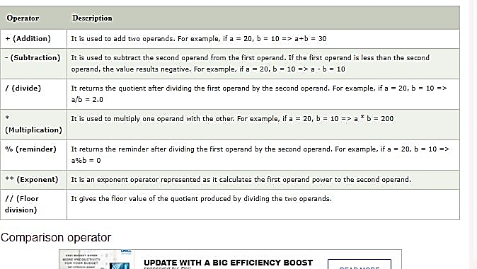
Arithmetic Operators

Slide 27
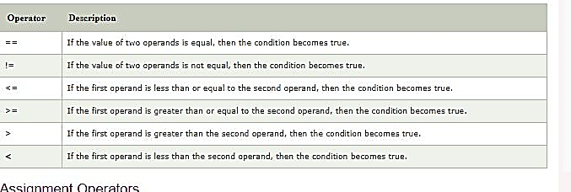
Comparison operators

Slide 28
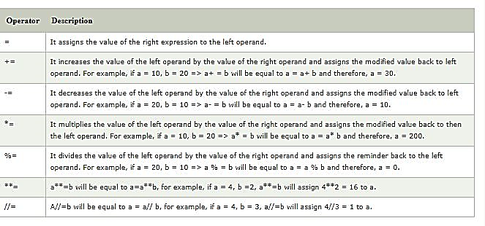
Assignment operators

Slide 29
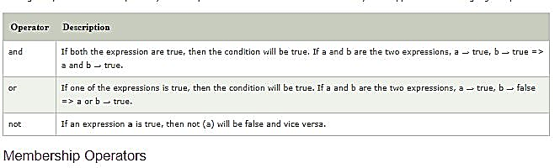
Logical Operators

Slide 30
List
Lists are used to store multiple items in a single variable
thislist = ["apple", "banana", "cherry"]
print(thislist)
List items are ordered, changeable, and allow duplicate values.
List items are indexed, the first item has index [0], the second item has index [1] etc.
Changeable- The list is changeable, meaning that we can change, add, and remove items in a list after it has been created.

Slide 31
List
Allow Duplicates - Since lists are indexed, lists can have items with the same value:
thislist = ["apple", "banana", "cherry", "apple", "cherry"]
print(thislist)
List items can be of any data type
list1 = ["apple", "banana", "cherry"]
list2 = [1, 5, 7, 9, 3]
list3 = [True, False, False]
A list can contain different data types:
list1 = ["abc", 34, True, 40, "male"]

Slide 32
List
Method Description
append() Adds an element at the end of the list
clear() Removes all the elements from the list
copy() Returns a copy of the list
count() Returns the number of elements with the specified value
extend() Add the elements of a list (or any iterable), to the end of the current list
index() Returns the index of the first element with the specified value

Slide 33
List
Method Description
insert() Adds an element at the specified position
pop() Removes the element at the specified position
remove() Removes the item with the specified value
reverse() Reverses the order of the list
sort() Sorts the list

Slide 34
Tuples
Tuples are used to store multiple items in a single variable
A tuple is a collection which is ordered and unchangeable.
Tuples are written with round brackets.
thistuple = ("apple", "banana", "cherry")
print(thistuple)

Slide 35
Tuples
Method Description
count() Returns the number of times a specified value occurs in a tuple
index() Searches the tuple for a specified value and returns the position of where it was found

Slide 36
Dictionary
Dictionaries are used to store data values in key:value pairs.
A dictionary is a collection which is ordered*, changeable and do not allow duplicates.
Dictionaries are written with curly brackets, and have keys and values:
thisdict = {
"brand": "Ford",
"model": "Mustang",
"year": 1964
}

Slide 37
Dictionary
print(thisdict)
Dictionaries cannot have two items with the same key:

Slide 38
Method Description
clear() Removes all the elements from the dictionary
copy() Returns a copy of the dictionary
fromkeys() Returns a dictionary with the specified keys and value
get() Returns the value of the specified key
items() Returns a list containing a tuple for each key value pair
keys() Returns a list containing the dictionary's keys
pop() Removes the element with the specified key
popitem() Removes the last inserted key-value pair
setdefault() Returns the value of the specified key. If the key does not exist: insert the key, with the specified value
update() Updates the dictionary with the specified key-value pairs
values() Returns a list of all the values in the dictionary
Dictionaries

Slide 39
Functions
In programming, a function is a reusable block of code that executes a certain functionality when it is called.
Functions are integral parts of every programming language because they help make your code more modular and reusable.
In Python, you define a function with the def keyword, then write the function identifier (name) followed by parentheses and a colon.
The next thing you have to do is make sure you indent with a tab or 4 spaces, and then specify what you want the function to do for you.

Slide 40
Functions (Basic Syntax)
def functionName():
#What to make the function do

Slide 41
Functions (Examples)
Example 1 : -
def myfunction():
print("Hello World")
To call this function, write the name of the function followed by parentheses:
myfunction()
Example 2:-
def subtractNum():
print(34 - 4)
subtractNum()
# Output: 30

Slide 42
Arguments in Python Functions
While defining a function in Python, you can pass argument(s) into the function by putting them inside the parenthesis.
The basic syntax for doing this looks as shown below:
def addNum(num1, num2):
print(num1 + num2)
addNum(2, 4)
I passed 2 arguments into the function named addNum
I told it to print the sum of the 2 arguments to the terminal
I then called it with the values for the 2 arguments specified

Slide 43
Return Keyword in Python
You can use the return keyword to exit a function so it goes back to where it was called. That is, send something out of the function.
The return statement can contain an expression to execute once the function is called.
def multiplyNum(num1):
return num1 * 8
result = multiplyNum(8)
print(result)
# Output: 64

Slide 44
Return Keyword in Python
I defined a function named multiplyNum and passed it num1 as an argument
Inside the function, I used the return keyword to specify that I want num1 to be multiplied by 8
After that, I called the function, passed 8 into it as the value for the num1 argument, and assigned the function call to a variable I named result
With the result variable, I was able to print what I intended to do with the function to the terminal

Slide 45
Built-in Functions
https://docs.python.org/3/library/functions.html

Slide 46
Set
A Set is an unordered collection data type that is iterable, mutable, and has no duplicate elements.
Set are represented by { } (values enclosed in curly braces)
The major advantage of using a set, as opposed to a list, is that it has a highly optimized method for checking whether a specific element is contained in the set.
var = {"Geeks", "for", "Geeks"}
type(var)

Slide 47
Set
# typecasting list to set
myset = set(["a", "b", "c"])
print(myset)
# Adding element to the set
myset.add("d")
print(myset)
OUTPUT :
{'c', 'b', 'a'}
{'d', 'c', 'b', 'a'}

Slide 48
Python if Statement
Python if Statement is used for decision-making operations. It contains a body of code which runs only when the condition given in the if statement is true. If the condition is false, then the optional else statement runs which contains some code for the else condition.
When you want to justify one condition while the other condition is not true, then you use Python if else statement.
https://www.guru99.com/if-loop-python-conditional-structures.html

